Slide 1



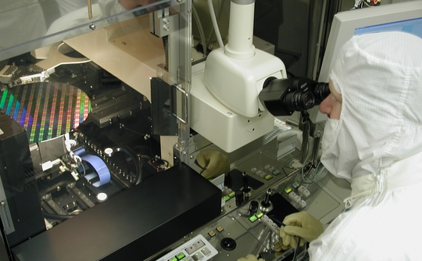
“The Lost Language of Privacy”- Brooks
UC Berkeley EECS Teaching Professor Dan Garcia
The Beauty and Joy of Computing Lecture #21
Data and Information
David Brooks waxes poetic about privacy in a NY Times piece about the pros/cons of police body cameras. He talks about why privacy is important to the development of full individuals, of families and friendships, and for communities. Read it!
www.nytimes.com/2015/04/14/opinion/david-brooks-the-lost-language-of-privacy.html

Slide 2
(Cal) Admin Notes
Schedule (see website)

Slide 3
Data and Information

Slide 4
Data & Information Facilitate Knowledge
Computers are used in an iterative and interactive way when processing digital information to gain insight and knowledge.
Digital information can be filtered and cleaned by using computers to process information.
Combining data sources, clustering data, and data classification are part of the process of using computers to process information.
Insight and knowledge can be obtained from translating and transforming digitally represented information.
Patterns can emerge when data is transformed using computational tools.

Slide 5
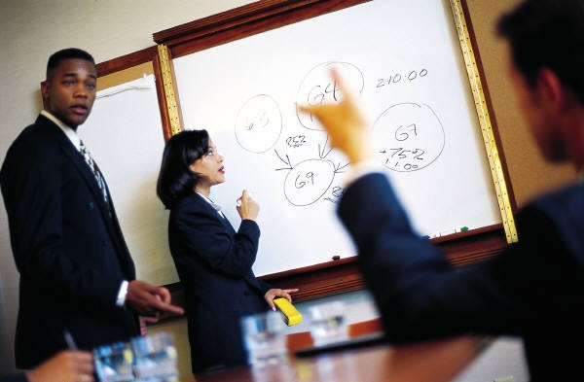
It’s a collaborative process!
Collaboration, in working with data to gain insight and knowledge:
…is an important part!
…applies multiple perspectives, experiences, and skill sets.
…involves communication between participants.
…includes developing hypotheses and questions, and in testing hypotheses and answering questions.
…can benefit from face-to-face and using online collaborative tools
…when Investigating large data sets can lead to insight and knowledge not obtained when working alone.

Slide 6
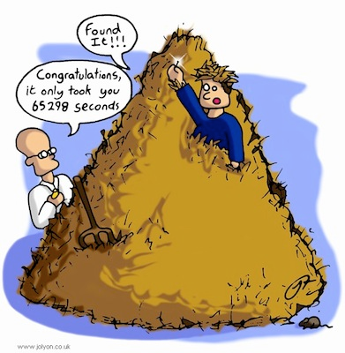
Extract information from data
Large data sets
provide opportunities and challenges for extracting information and knowledge.
provide opportunities for identifying trends, making connections in data, and solving problems.
Need computing tools to facilitate the discovery of connections
For efficiently finding, recognizing patterns and finding trends in information…
Search tools are essential.
Information filtering systems are important tools
Software tools, including spreadsheets and databases can help

Slide 7
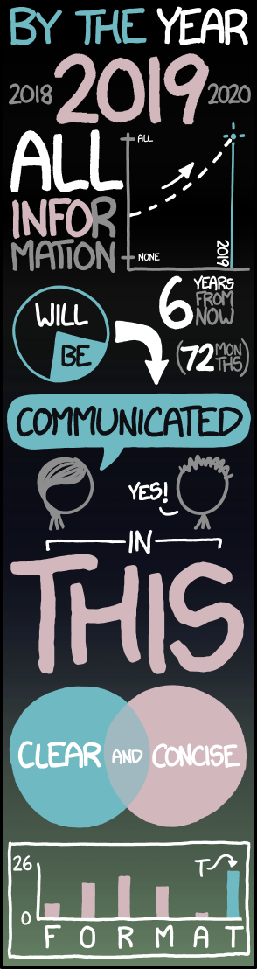
Big Data Concerns
Large data sets include data such as transactions, measurements, texts, sounds, images, and videos.
The storing, processing, and curating of large data sets is challenging.
Structuring large data sets for analysis can be challenging.
Maintaining privacy of large data sets containing personal information can be challenging.
Scalability of systems is an important consideration when data sets are large.
The size or scale of a system that stores data affects how that data set is used.
Analytical techniques to store, manage, transmit, and process data sets change as the size of data sets scale.
xkcd.com/1273

Slide 8
Ubiquitous data
…we work with it all the time:
Data is collected any moment of your life
Data is stored, copied, transmitted, deleted, edited.
Computers perform operations on data
Data enters and exits through sensors
We can measure it!
1 bit = ‘0’ | ’1’
1 Byte = 8 bits
1 KiB = 1024 Bytes, 1MiB = 1024 KiB, 1GiB = 1024 MiB, 1TiB=1024 GiB, 1PiB = 1024 TiB, …

Slide 9
How much is?
1 KiB?
Paragraph of text
1 MiB?
4 Mega pixel JPEG (compressed) image
1 GiB?
One hour of SD TV or 7 minutes of HDTV
1 TiB?
2,000 hours of audio (uncompressed), 17,000 hours of MP3s
1 PiB?
Enough data to store the DNA of the entire population of the US – three times!
☑

Slide 10
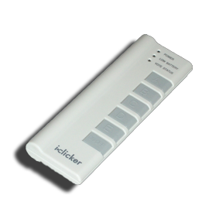
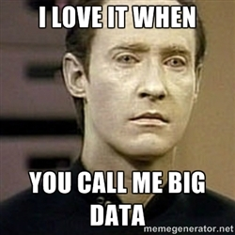
(Cal) Clicker Question
What do you think is the biggest data overall?
Text
Images
DNA
Videos
Census Data
Notes:
Data and information is hard to define. There are philosophical and meta-physical issues. So let’s all watch the Matrix…

Slide 11
Big Data, Compression, Metadata

Slide 12
Big Data
Netflix is said to use 1 PB to store the videos for streaming.
World of Warcraft is stored on 1.3PB to maintain the game.
Internet Archive: About 10PB
AT&T transfers about 30PB of data through its networks each day.
YouTube processes about 40PB of videos a day.
Multimedia data is the biggest data!

Slide 13
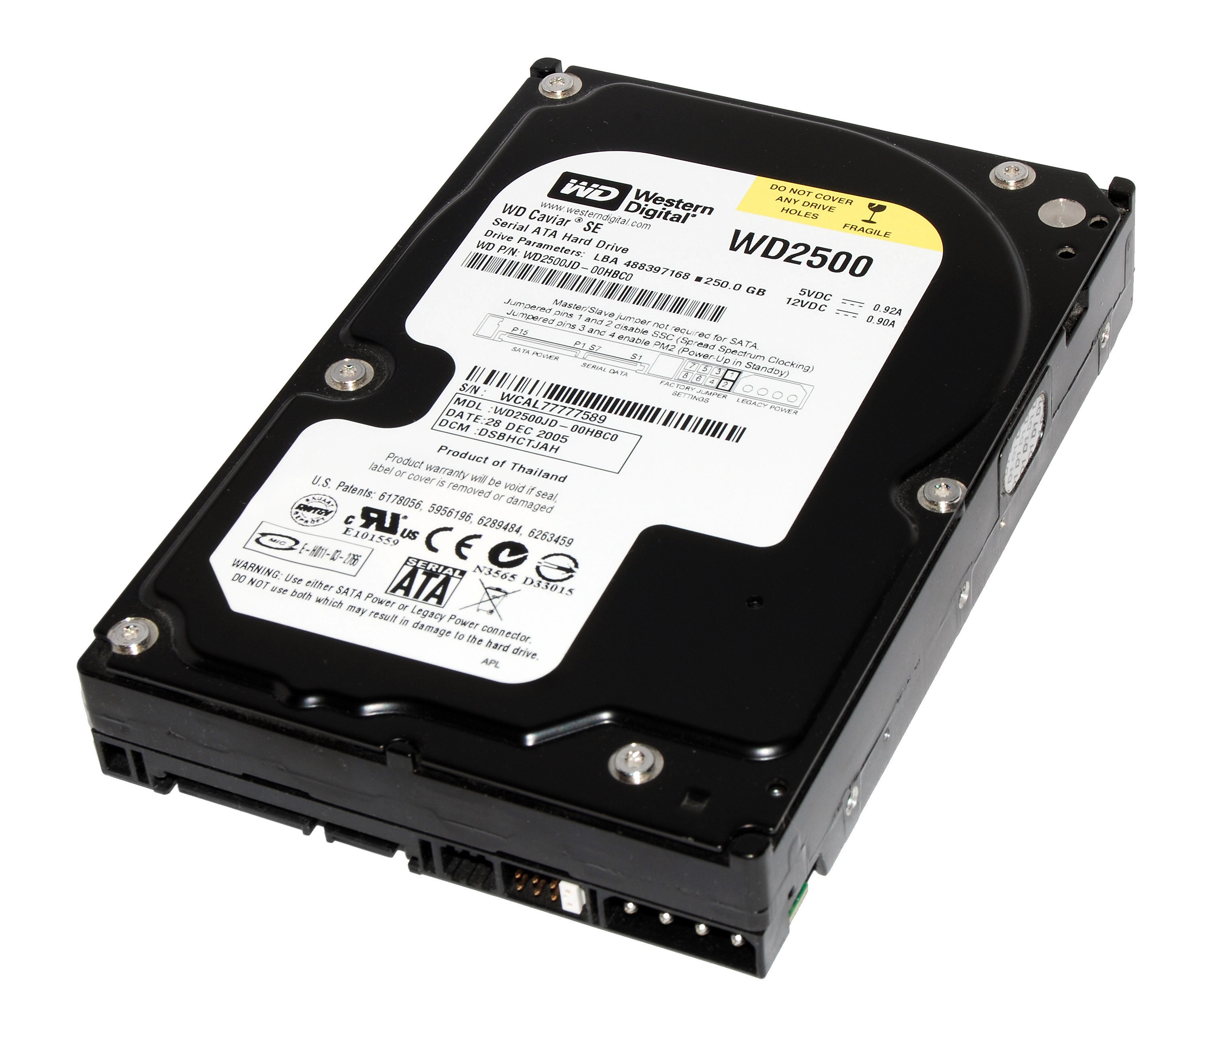
Challenges
Storage
No single hard disk/memory unit can store the data
Need to parallelize harddisks
All the problems of concurrent programming!
How to access the data?
What if a disk fails?
How fast is the access (read, write, delete)?
Physical limits: Energy cooling

Slide 14
Helpful Techniques: Lossless Compression
Entropy compression reduces data volume by removing redundant information (so fewer bits are used to store or transmit it!)
This compression is reversible but has mathematically proven limits.
Example:
AAAAAABBBBBCCC -> 6A5B3C

Slide 15
Helpful Techniques: Lossy Compression
Lossy compression reduces data volume by removing irrelevant information (and often can yield smaller files than lossless)
This compression is not fully reversible but only has perceptual limits.
There are trade-offs in using lossy and lossless compression techniques for storing and transmitting data.
Compression needs an agreement on decompression = “format”

Slide 16
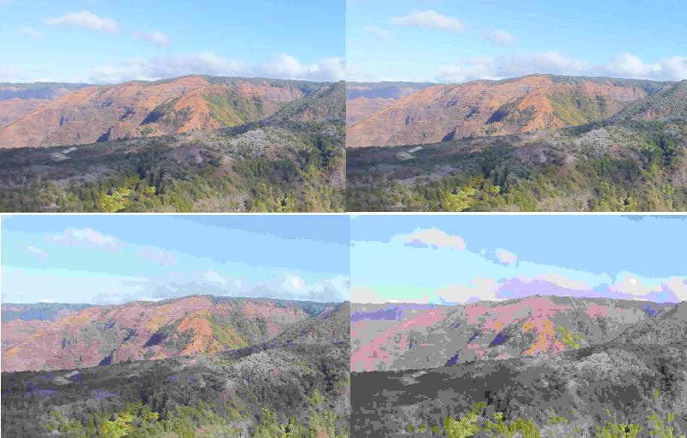
Lossy Compression Example: JPEG

Slide 17
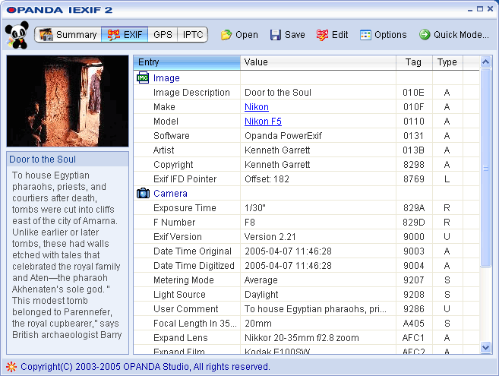
Techniques that help: Metadata
Metadata: Data about data
can be descriptive data about an image, a Web page, or other complex objects.
can increase the effective use of data or data sets by providing additional information about various aspects of that data.
(e.g., search)

Slide 18
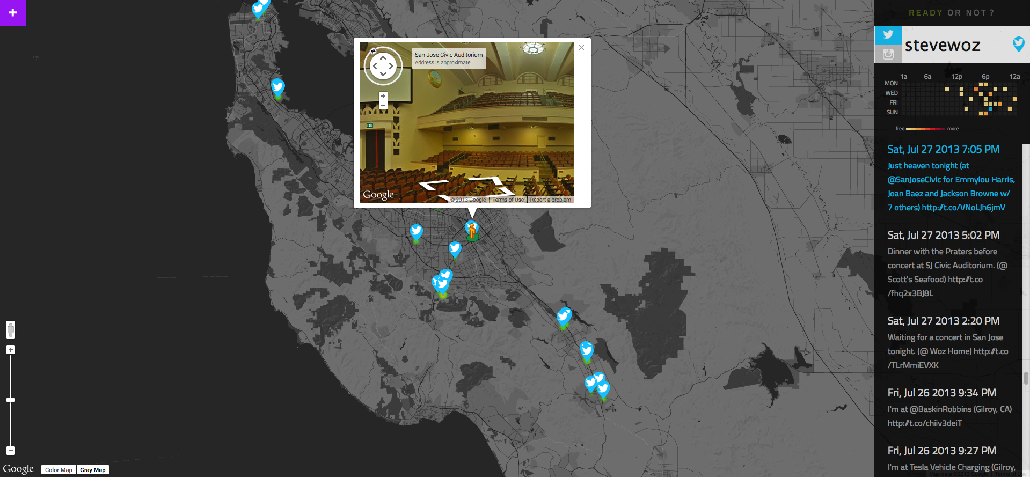
Main Reason for Digital Data
Digital data can be copied without loss, and sent instantly, permanently to everyone.
Data is stored in many formats depending on its characteristics (e.g., size and intended use).
The choice of storage media affects both the methods and costs of manipulating the data it contains.
Reading data and updating data have different storage requirements.
Problems with data that contains personal information:
Privacy
Security
Trade-offs in storing, transmitting

Slide 19
Main Reasons for Big Digital Data
Analyzing data at Internet-scale helps understand the world on never-before-seen scale.
Useful for empirical sciences:
What are the economic trends based on Google searches?
Are there animals that dance to music without human training?
How is the flu progressing?
`www.google.org/flutrends/us/
☑

Slide 20
Data: Conclusions and Visualization

Slide 21
Is Data the Solution to Everything?
“Even” Internet data is biased
It’s easy to draw conclusions too quickly
Sometimes finding the questions to ask is the hard part…
E.g., NetFlix Prize
“Predict whether someone will enjoy a movie based on how much they liked or disliked other movies”
Dataset: users and movie ratings
What questions can we ask of this data set?

Slide 22
Correlation does not Imply Causality!
en.wikipedia.org/wiki/Correlation_does_not_imply_causation!
cum hoc ergo propter hoc logical fallacy:
A occurs in correlation with B.
Therefore, A causes B.
Just because A and B are correlated does not necessarily imply one causes the other! It could be that…
A may be the cause of B
B may be the cause of A
some unknown third factor C may actually be the cause of A and B.
A caused B AND B caused A. This is a self-reinforcing system.
E.g., “preditor-prey” relationships
the "relationship" is a coincidence or so complex or indirect that it is more effectively called a coincidence (i.e. two events occurring at the same time that have no direct relationship to each other besides the fact that they are occurring at the same time).

Slide 23
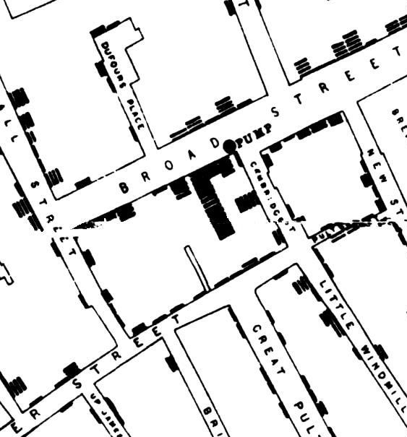
Benefits of Visualizations
en.wikipedia.org/wiki/1854_Broad_Street_cholera_outbreak
Visualization tools and software can communicate information about data
To communicate effectively the insights and knowledge gained from digitally represented information
Summarize the data analyzed computationally
Transform the information
Tables, diagrams, and textual displays
Interactivity with data is an aspect of communicating
John Snow’s visualization of the outbreak of Cholera in 1854 London

Slide 24
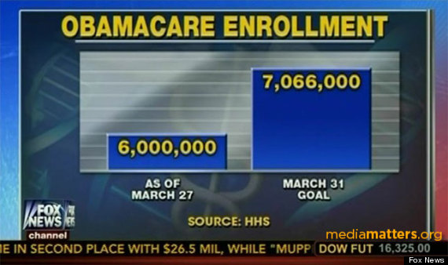
Visualization … Epic FAIL (2014)
www.huffingtonpost.com/2014/03/31/fox-news-obamacare-graphic_n_5063582.html

Slide 25

Visualization … Epic WIN (1869)
www.edwardtufte.com/tufte/posters
Charles Joseph Minard, Napoleon’s 1812 Russian Campaign

Slide 26
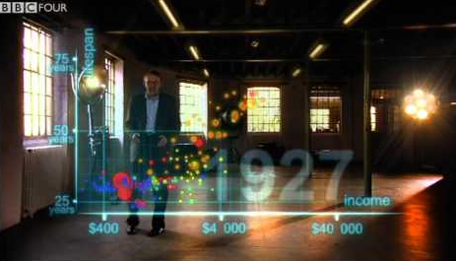
Visualization … Epic WIN (2009)
youtu.be/jbkSRLYSojo
Hans Rosling’s 200 countries, 200 years, 4 minutes – the joy of stats

Slide 27
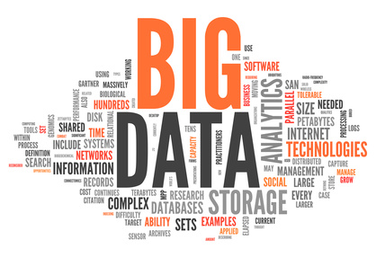
Summary
The right questions need to be answered by the proper data.
The rewards are high but handling data is an ongoing challenge to computer scientists as well as security specialists and privacy preservers.

Slide 28
Data & Information Facilitate Knowledge
Computing enables and empowers new methods of information processing that have led to monumental change across disciplines, from art to business to science.
Managing & interpreting an overwhelming amount of raw data is part of the foundation of our information society and economy.
People use computers and computation to translate, process, and visualize raw data, and create information.
Computation and computer science facilitate and enable a new understanding of data and information that contributes knowledge to the world.
You will work with data using a variety of computational tools and techniques to better understand the many ways in which data is transformed into information and knowledge.

